Slide 1
Mount Ağrı, Turkey's largest mountain
Ağrı 5.137-meter altitude, is the highest mountain of Turkey
43. the world's highest mountain

Slide 2
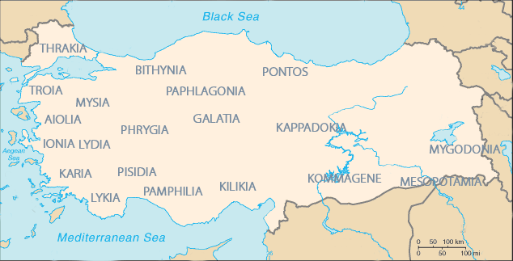
Ancient Civilizations

Slide 3
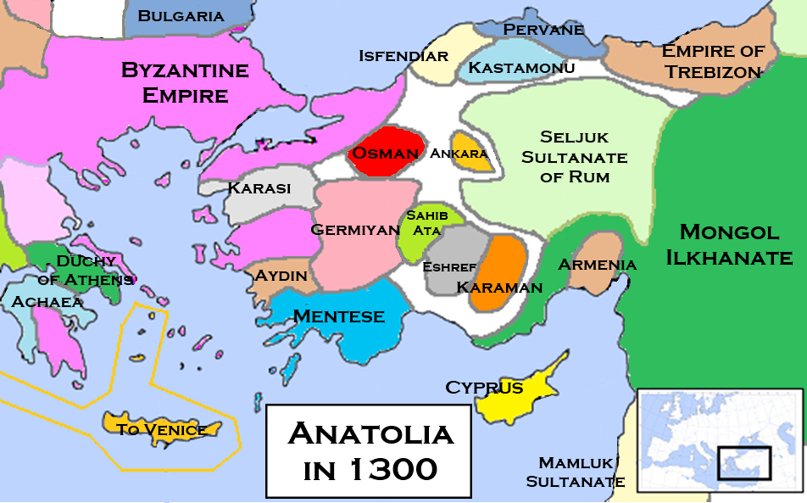
Turkey Through History

Slide 4
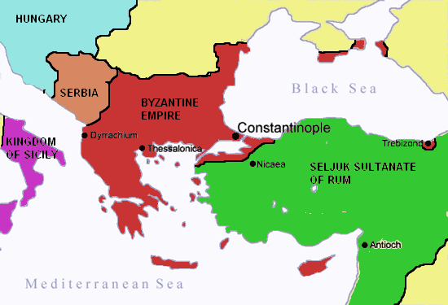
Before Conquered Istanbul(By Fatih Sultan Mehmet Han, The Ottoman Empire)

Slide 5
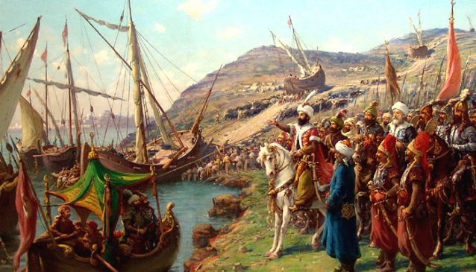
In 1453, By Fatih Sultan Mehmet Han, Istanbul Was Conquered

Slide 6
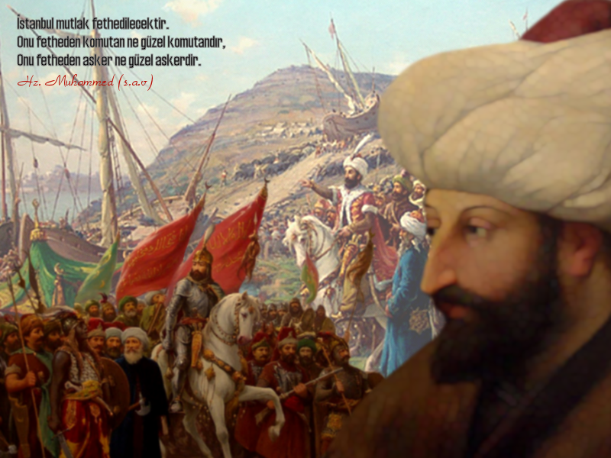
The Medieval Period Was Closed And A New Age Began

Slide 7
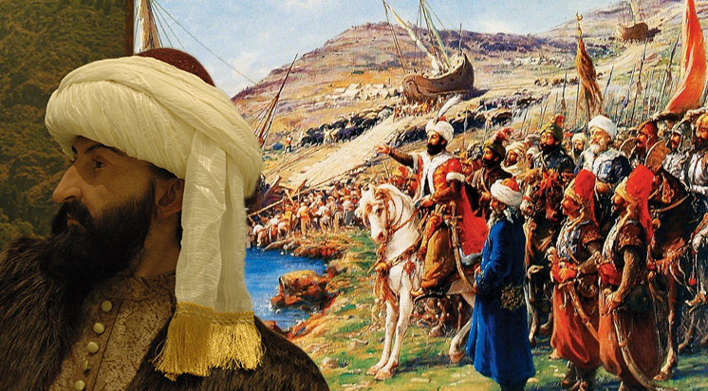
Fatih Sultan Mehmet Took The Throne At The Age Of 19 Knew 7 Foreign Languages.

Slide 8
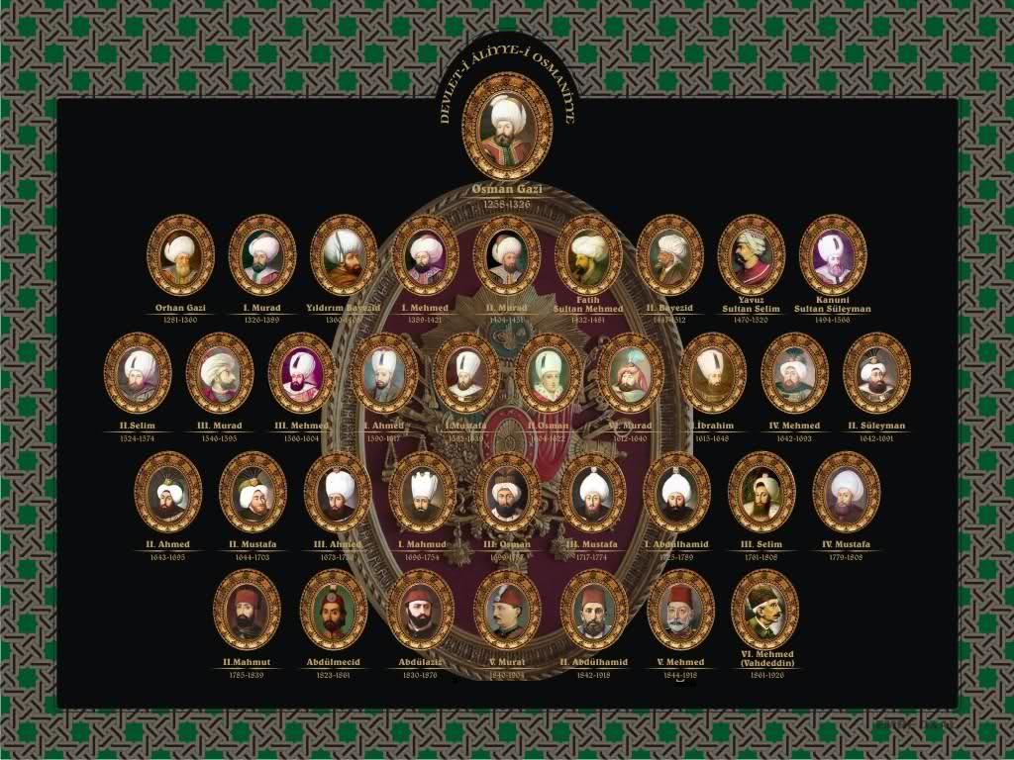
OTTOMAN EMPERORS

Slide 9
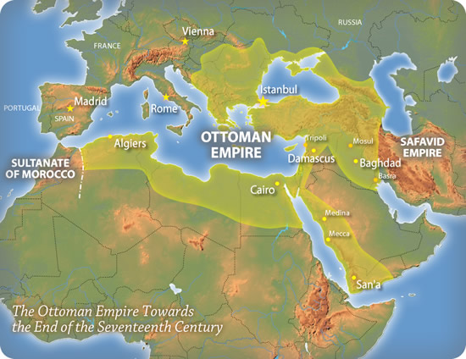
Ottoman Empire extension For 600 Years in Europe, Asia And Africa

Slide 10
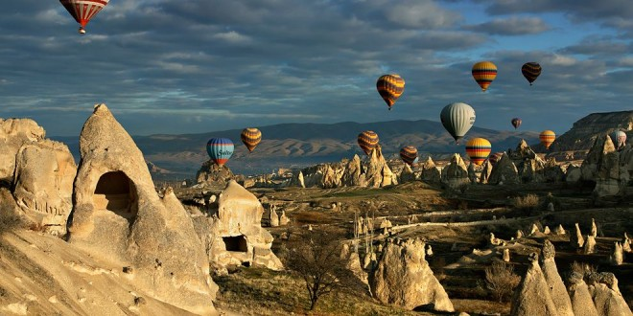
THE CİTY CAPPADOCIA (palaeolithic )

Slide 11
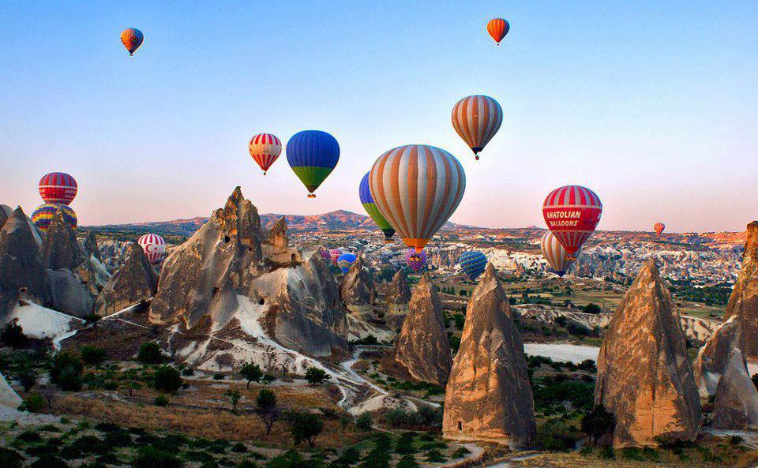
BALOON TOURS (Kapadokya)

Slide 12
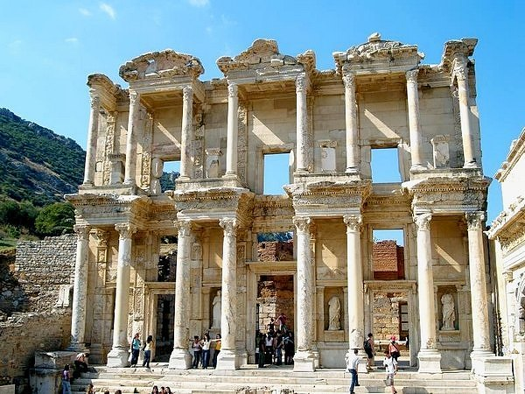
The City Of Antalya, Ephesus Was made in 6000 BC (Neolithic age)

Slide 13
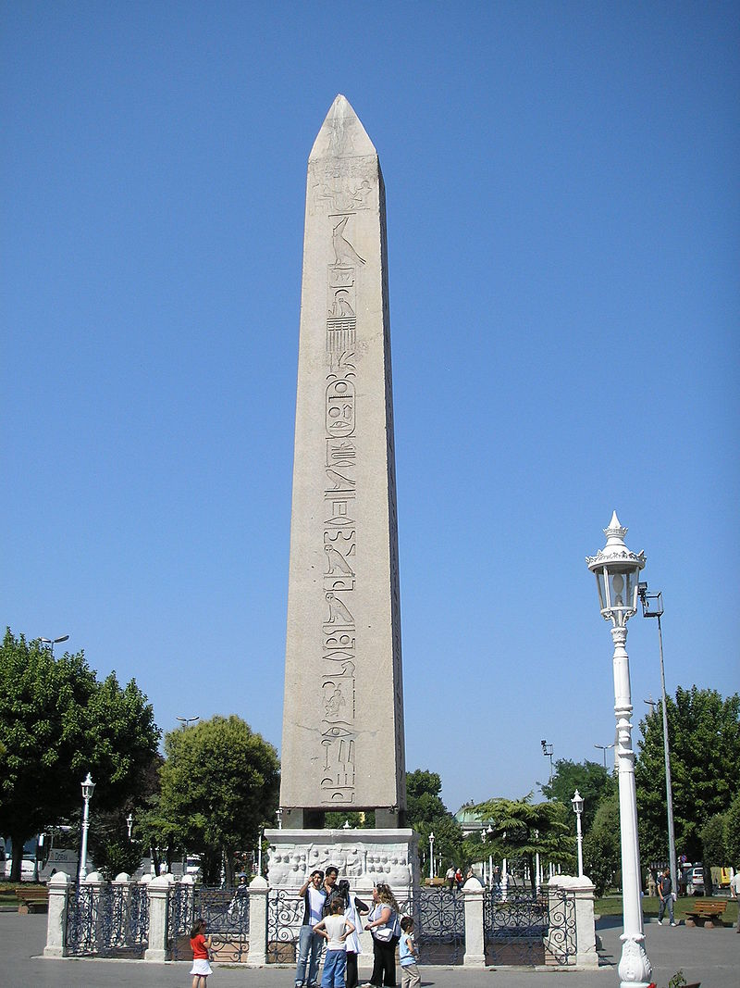
The City Of Istanbul ,Dikilitaş ,egyptian pharaoh III. Built BC 15th century by tuthmosis

Slide 14
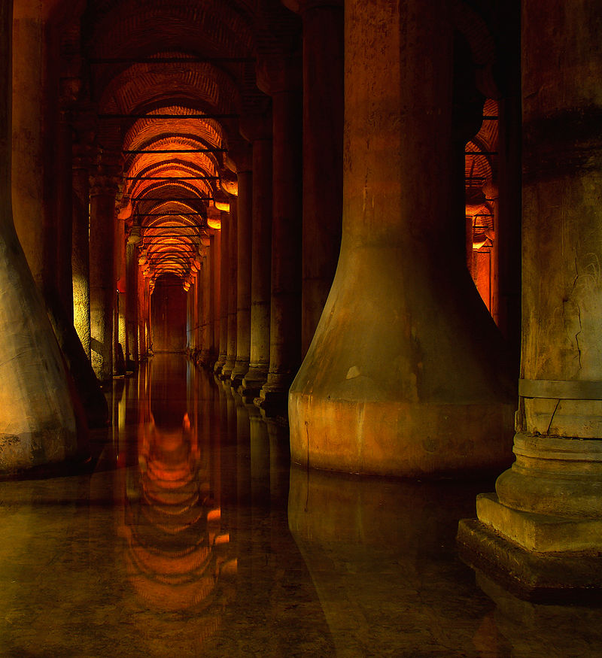
Byzantine Emperor Justinian I (527-565) Built the BASİLİCA CİSTERN

Slide 15
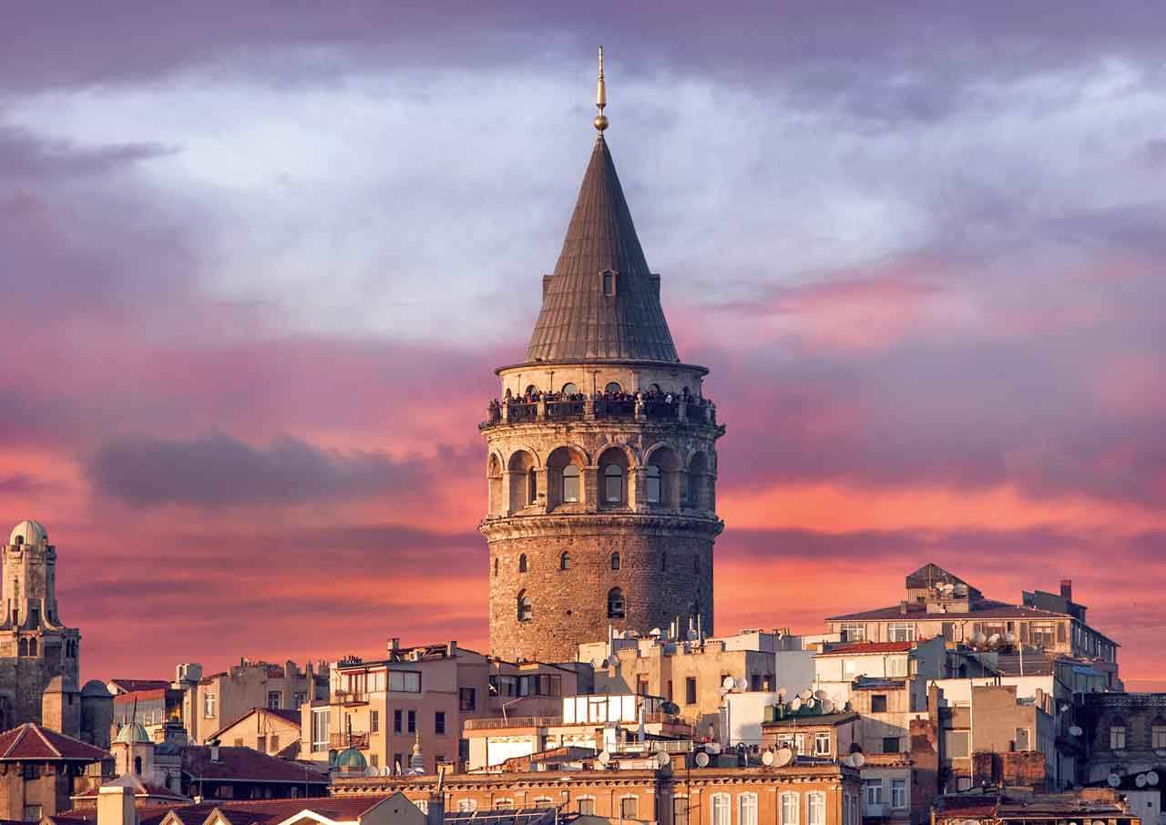
By Byzantine Emperor anastasius in 528 as a lighthouse was built,GALATA KULESİ

Slide 16
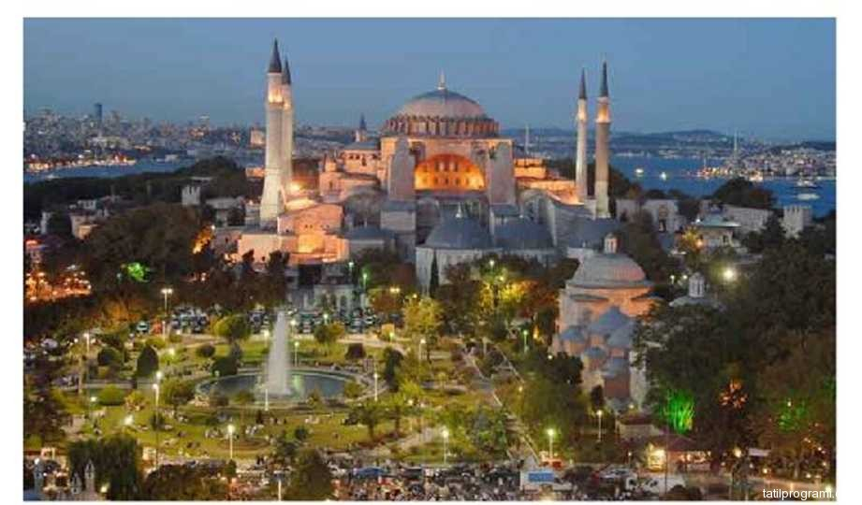
AYASOFYA MOSQUE, THE CİTY OF İSTANBUL (by the Byzantine Emperor I. Justinian, MS 532 - 537 was made in)

Slide 17
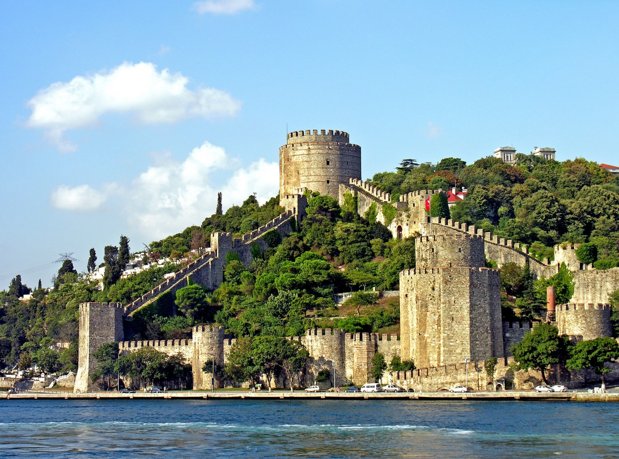
Rumelihisari Was Built In 1452 By The Ottoman Empire

Slide 18
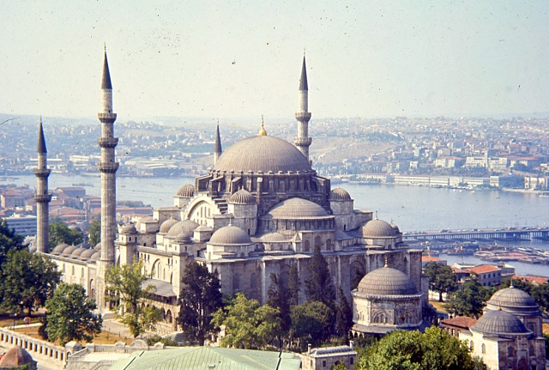
Suleymaniye Mosque Was Built İn 1558

Slide 19
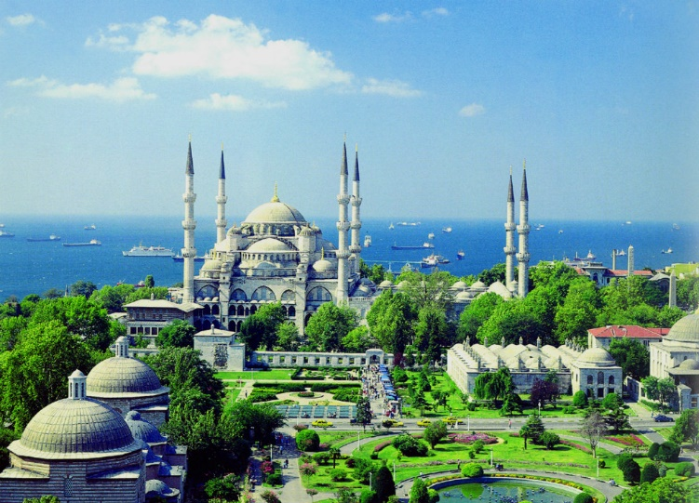
SULTANAHMET CAMİİ It was build by the Ottoman Sultan Ahmed 1616

Slide 20
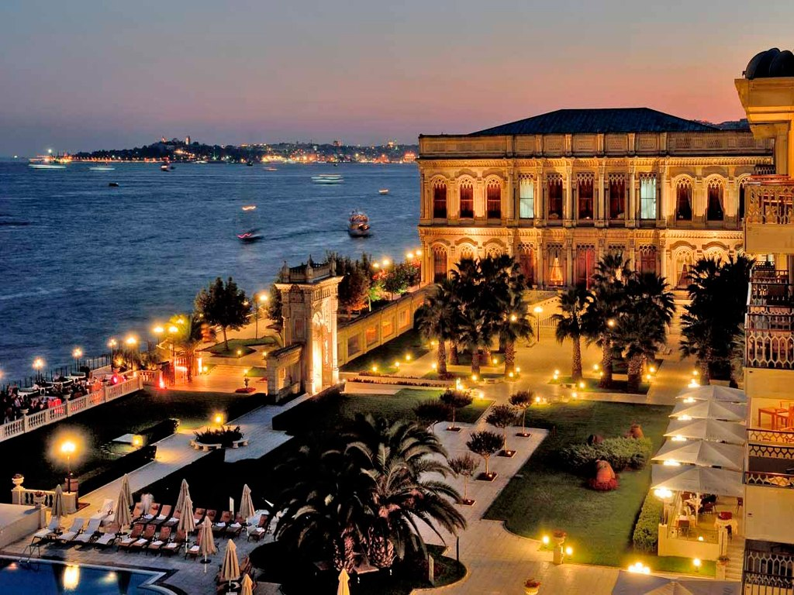
Çırağan Palace, The City İstanbul In 1703 was made

Slide 21
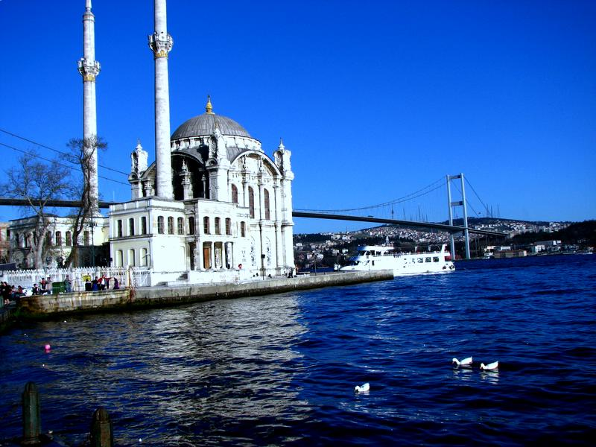
Ortaköy Mosque Was Built By Ottoman Emperor Sultan Abdulmecid In 1853

Slide 22
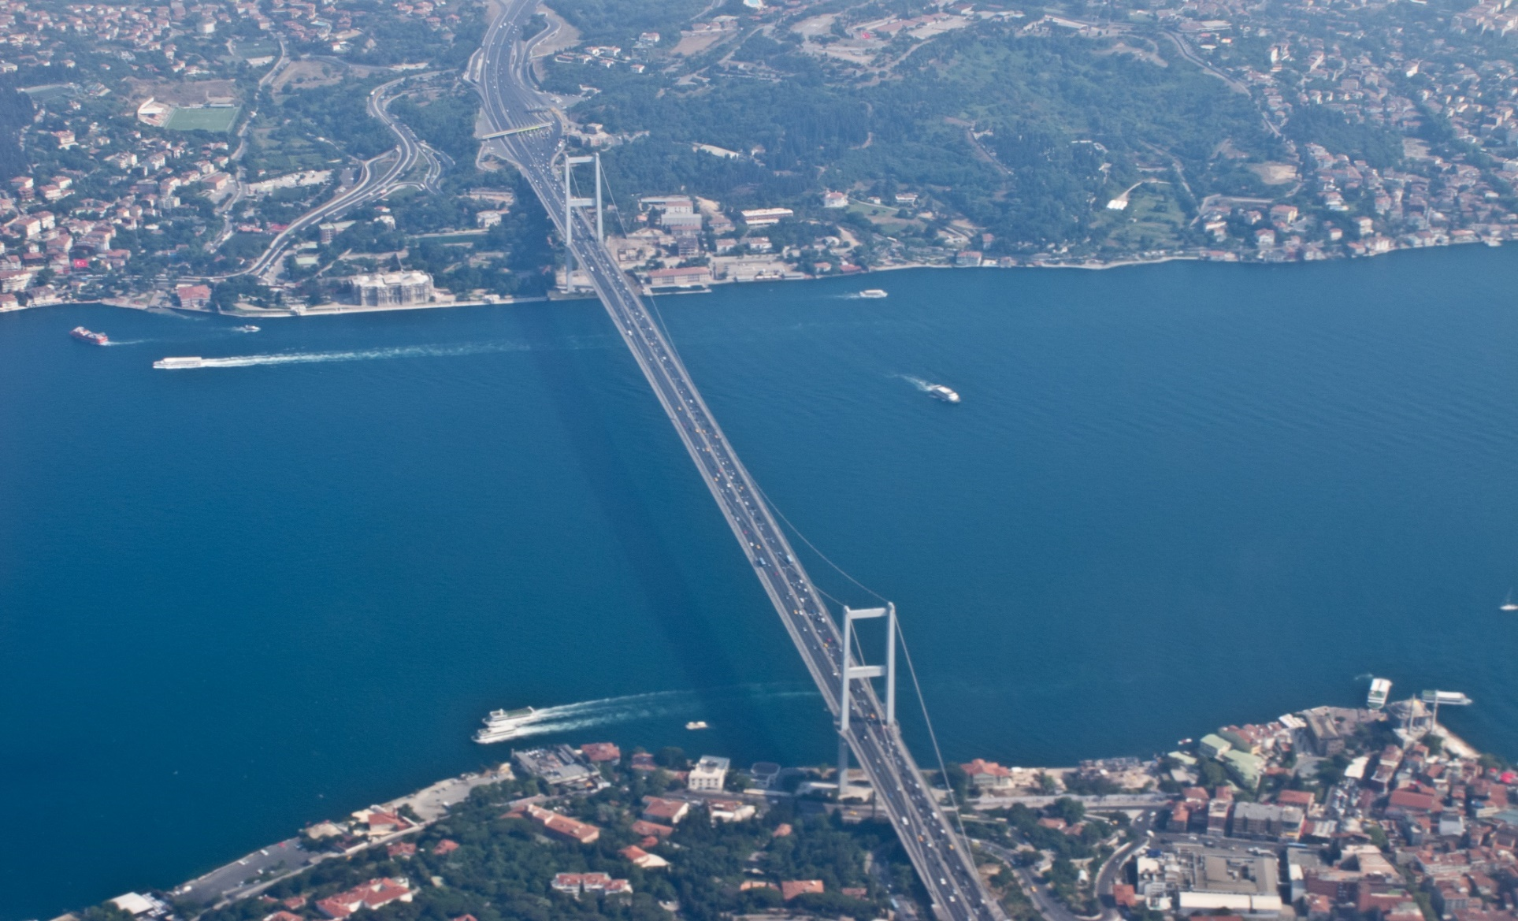
Boğaziçi Bridge ,The Only Passage That Connects Europe And Asia

Slide 23
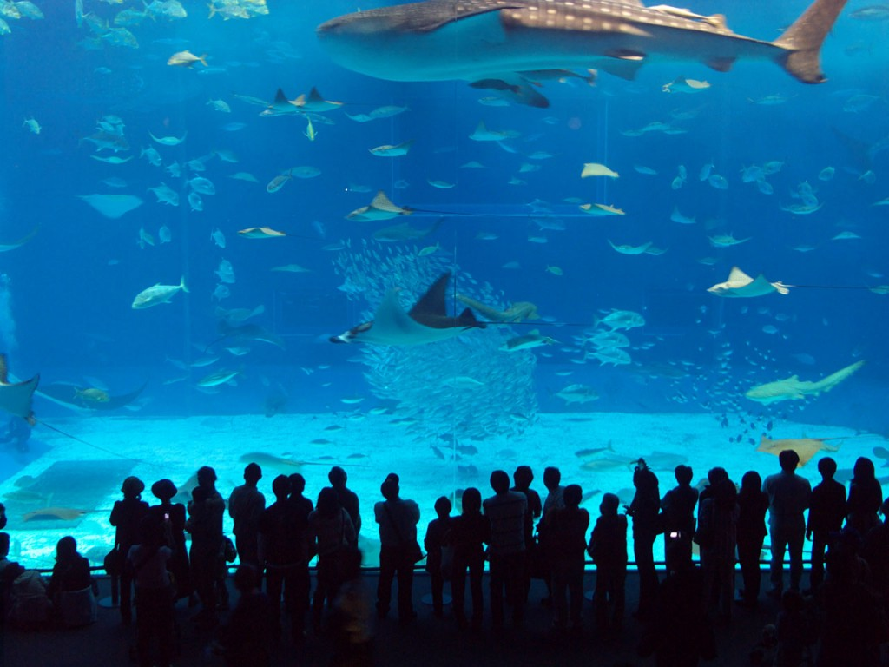
İstanbul Sea Life Akvaryum, today

Slide 24
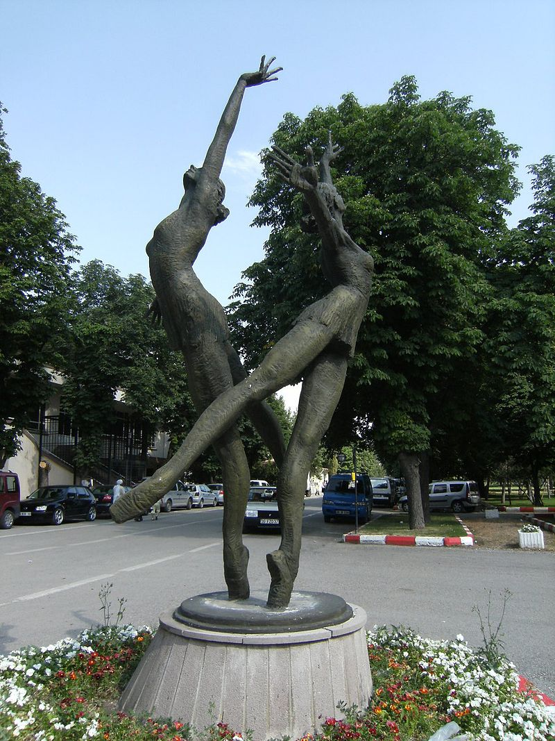
The City Of Ankara Ballet Girls

Slide 25
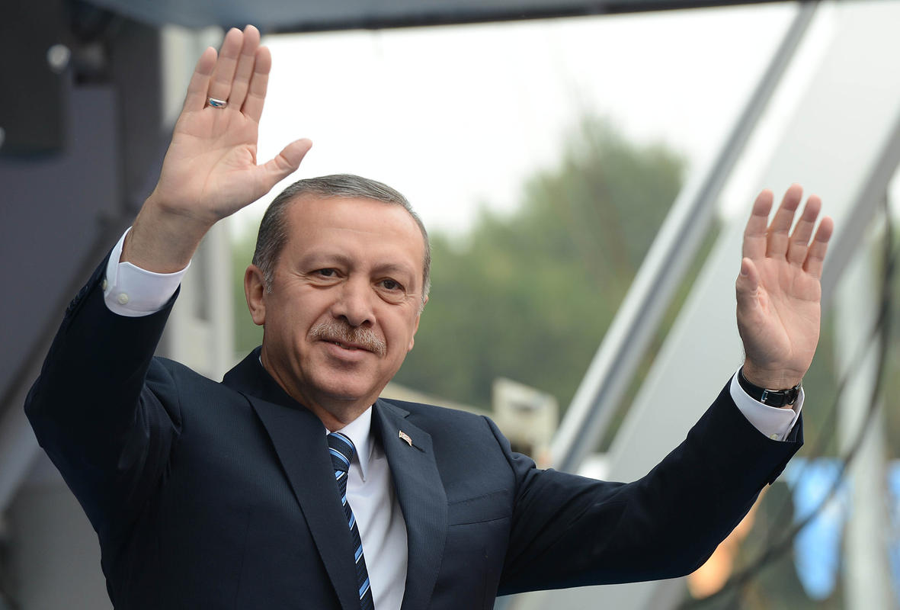
Recep Tayyip Erdogan, was Prime Minister For 11 Years

Slide 26
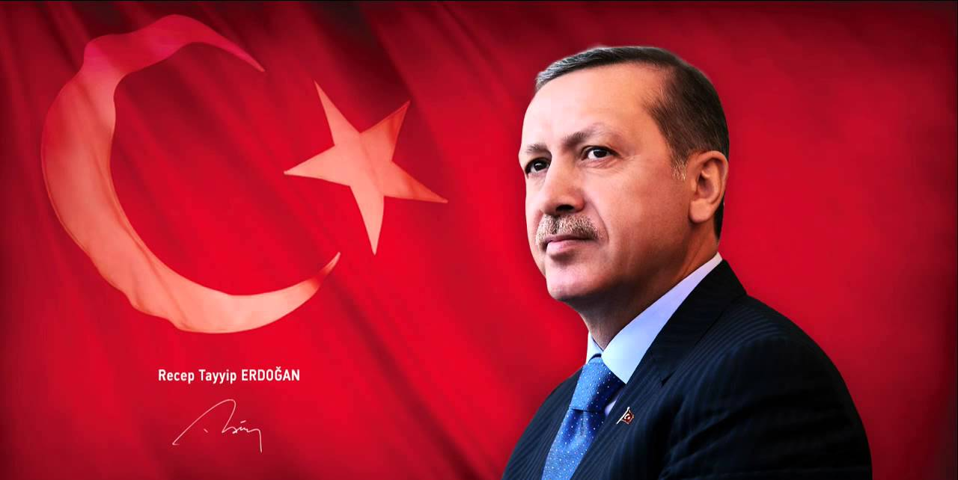
Recep Tayyip Erdoğan Turkey 12* President (Today)

