Slide 1
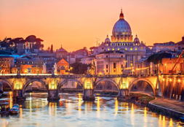
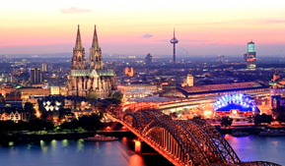
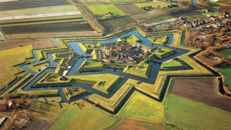
Netherlands

Slide 2
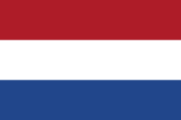
Topics
Introduction
Brief Facts about the Netherlands
Geography
Geographic location
A little of history
Provinces of the Netherlands
Territories
Why the Netherlands?
Major cities
The coat of arms
The flag
The language
The capital
Culture
Religion

Slide 3
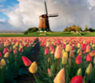
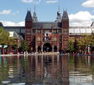
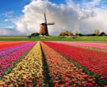

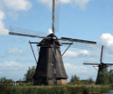
Politics
Industry and economy
Top Companies in the Netherlands
Main Industries
Mineral resources
The coin
The National Anthem
National Anthem Sheet Music
Traditional costumes
Traditional dance
Traditional Gastronomy
Tourist Attractions and Monuments
Curiosities
Synthesis
Web spelling

Slide 4
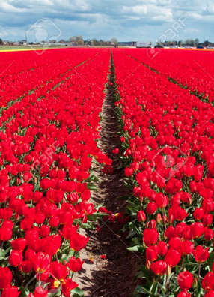
Introduction
The Netherlands is generally known for its flat landscape, which is ¼ of its submerged territory or sea level and is therefore very interesting, which is the true origin of the name Netherlands.
The Netherlands has over 1000 windmills and countless fields of colorful tulips. They are also an economically and technologically developed region with several qualities also in the creation of large companies.

Slide 5

Brief facts about the Netherlands
Capital: Amsterdam
Language: Dutch
Euro currency
Flag:
Coat of arms:
Politics: Constitutional Monarchy

Slide 6
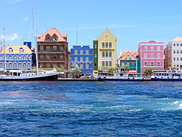
Geography
Capital: Amsterdam
Total surface area: 41 526 𝑘𝑚2
Population: 16.4 million

Slide 7
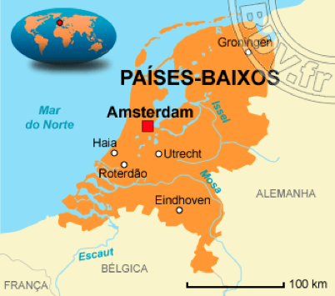
Geographic location
Positioned in the plains of northern Europe (in Western Europe). The Netherlands is surrounded by the North Sea, it also borders Belgium (to the South) and Germany (to the East).

Slide 8
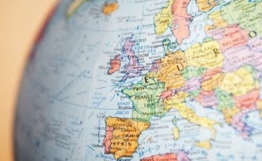
A little of History
History of the Netherlands began in the prehistoric period, with the Dutch territory having been inhabited since the Paleolithic, a few years later in the medieval period, the region of the Netherlands was unified in a single state by the House of Habsburg.
Around 1600, the Netherlands was considered a country, but it was only in 1648 with the Treaty of Münster that the Dutch and Spanish formally formed peace.

Slide 9
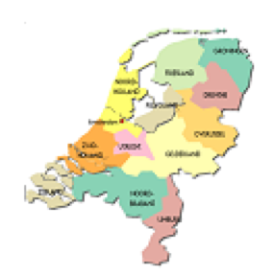
Provinces of the netherlands
There are twelve provinces that make up the Netherlands:
To the north: Groningen; Friesland; Drente;
To the east: Overissel; Gelde; Flevoland;
To the west: Utrecht; North Holland and South Holland; Zealand;
To the south: North Brabant; Limburg.
The most recent additions to the country are the islands Bonaire, Saint Eustatius, Saba, Curacao and Saint Marteen who joined the country in October 2010.

Slide 10
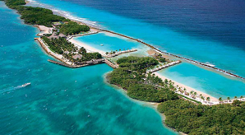
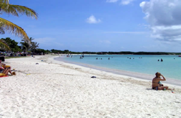
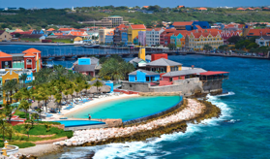
Territories
The Netherlands has three autonomous territories: Aruba island, Saint Martin island and Curacao island.
The three territories are independent in internal affairs but subject to central control by the Kingdom of the Netherlands in matters of defense and assistance.

Slide 11
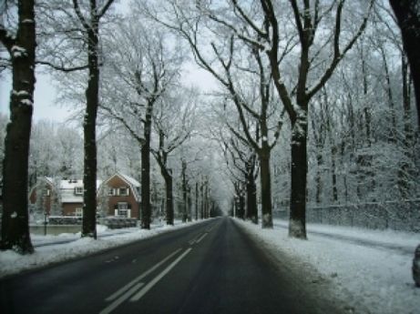
Why the Netherlands?
The Netherlands is called "The Netherlands" because of its low altitude, which sometimes proves to be negative.

Slide 12
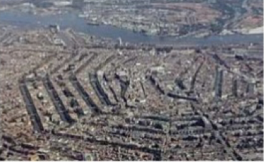
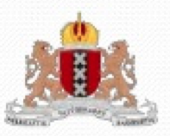
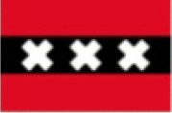
Major cities
Amsterdam
Coat of arms
Flag

Slide 13
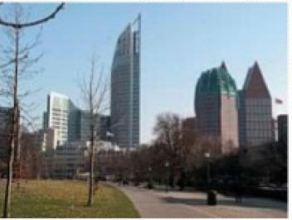
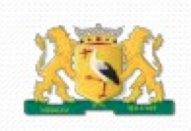
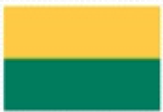
Haia
Coat of arms
Flag

Slide 14
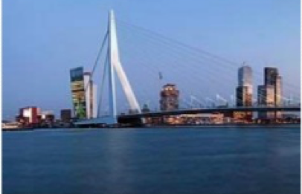
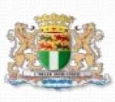
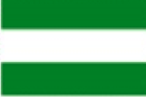
Roterdam
Coat of arms
Flag

Slide 15
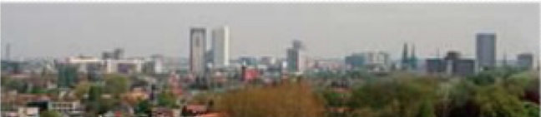
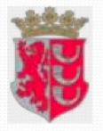

Eindhoven
Coat of arms
Flag

Slide 16
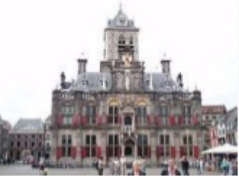
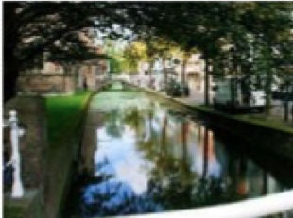
Delft

Slide 17
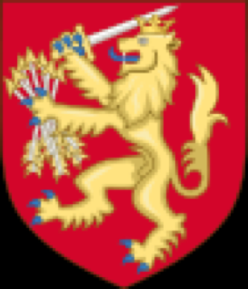
The coat of arms
The coat of arms of the Netherlands is the symbol of the Dutch monarchy.
The lion is crowned, and has a set of seven arrows in his left hand, and a sword in his right hand. These charges are derived from the United Provinces. The seven arrows represent the seven provinces of the Netherlands that revolted against Spain in 1568.

Slide 18
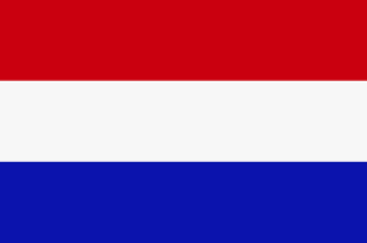
The flag
It represents blood spilled by the people during World War II.
It represents peace between North Holland and South Holland.
It represents the Sea around the Netherlands, which also gives the name to him of Netherlands.

Slide 19
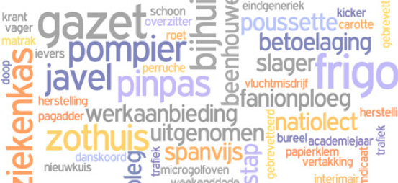
The language
The language used in the Netherlands is Dutch.

Slide 20
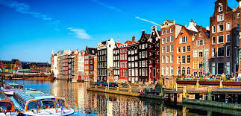
The capital
The capital od Netherlands is Amsterdam.

Slide 21
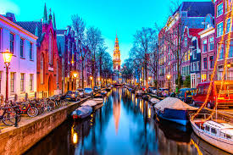
Amsterdam was born at the mouth of the river Amstel, in a region that had no more than extensive lakes and marshes that were below the average level of sea water. The shallow sea of the south was conquered by the small communities that lived there thanks to the construction of canals and dikes. The city began to be designed as we know it today, around the year 1200, when a small fishing community was established in the place where today is the beautiful Dam square. In the following centuries, Amsterdam became one of the main commercial ports of Europe, connecting the cities of the Hanseatic League with the south of the continent. At the end of the century. XV, more than half of the navigation of the Baltic Sea was of Dutch origin.

Slide 22
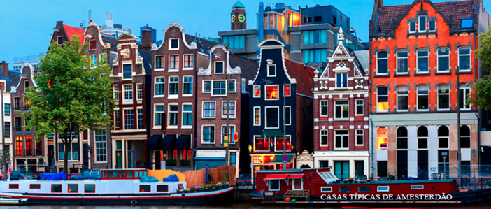
Capital: typical houses

Slide 23
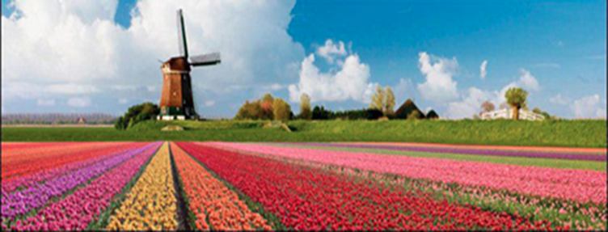
Capital: tulip field

Slide 24
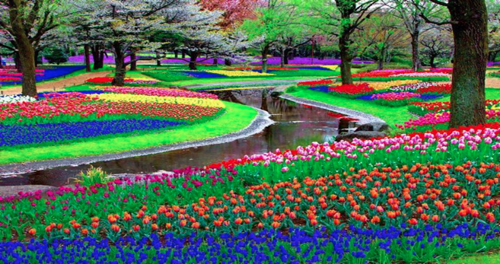

Slide 25
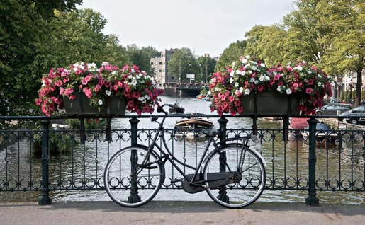
Capital: Typical bicycles

Slide 26
Culture: painting
It was a country that marked the history of European painting, during the time of the Dutch masters like Rembrandt Van Rijn, Johannes Vermeer and Jan Steen. Without forgetting in the 19th and 20th centuries Piet Mondrian and Vincent Van Gogh.

Slide 27
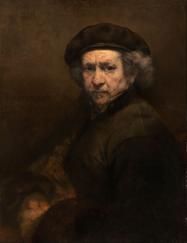
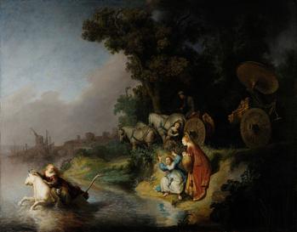
Culture: Painting - some famous painters and their paintings
Rembrandt Van Rijn

Slide 28
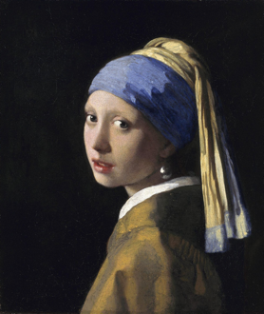
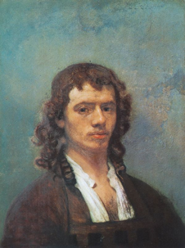
Johannes Vermeer

Slide 29
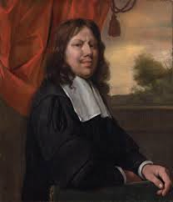
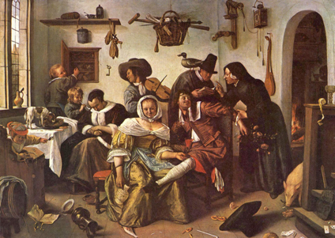
Jan Steen

Slide 30
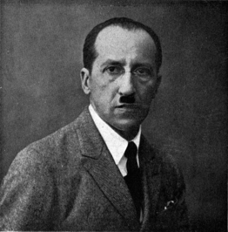
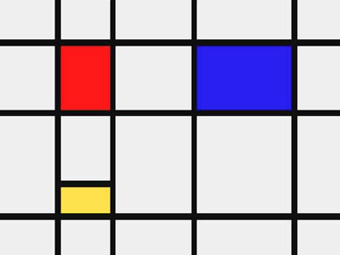
Piet Mondrian

Slide 31
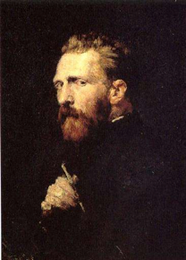
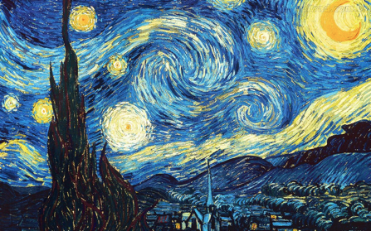
Vincent Van Gogh

Slide 32
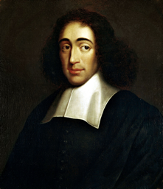

Culture: Philosophy
He gave the Renaissance Eramos of Rotterdam and later with the religious tolerance Baruch de Spinoza and René Descartes.

Slide 33





Culture
The main objects related to the Netherlands are:

Slide 34

Religion
The Netherlands is one of the most secularized countries in Western Europe, with 39% of the population belonging to a religion.
Less than 20% regularly attend their churches and the minority of practically the religion is divided into Catholics (18%) and Protestants (15%).

Slide 35
Politics
From 1815 until today the Netherlands is a constitutional monarchy. Before that a republic (from 1581 to 1806)
A little history of Politics
After the French occupation in the early nineteenth century, the Netherlands became a monarchy, ruled by the House of Orange. However, after a conservative period, strong liberal sentiments could not be ignored, and the country became a parliamentary democracy with a constitutional monarchy in 1848. It has remained so ever since, with a brief interruption during Nazi Germany's occupation.

Slide 36


The political system of the Netherlands is the constitutional monarchy since 1815 and a parliamentary democracy since 1848.
The parliament consists of two chambers: the lower house (whose members were directly elected) and the upper chamber 8 with 75 members, indirectly elected and with limited powers).

Slide 37
Industry and economy
Euro currency
Fiscal Year: Year Calendar
Trade blocs: WTO, European Union, OECD
Central Bank: De Nederlandsche Bank

Slide 38

The Dutch economy is very strong and has played a special role in the European economy for many centuries. Since the 16th century, transportation, fishing, commerce and banking have been important sectors of the economy. It is one of the ten largest exporting nations
Main industries: agroindustry, metal and engineering products, electrical machinery and equipment, chemicals, petroleum, civil construction, microelectronics, fishing.

Slide 39




Top companies in Netherlands
Unilevev
C&A
Sheel
Philips

Slide 40

Main industries
Agribusiness, metal products and engineering, electrical machinery and equipment, chemicals, petroleum, construction, microelectronics, fishing.

Slide 41
Mineral resources
With the exception of the coal basin in Limburg and the salt used in Hengelo, mineral resources in the Netherlands were very poor until the late 1960s. The discovery and exploration of natural gas deposits in Groningen have turned this around. Small oil deposits are also explored in the west and on the continental shelf of the North Sea.

Slide 42

The coins
The currency used in the Netherlands is the euro.

Slide 43
The national anthem
Lyrics: Unknown
Composition: Adrianus Valerius
Adopted: 1932 (the oldest in the world)
Theme: The life of Guillaume de Oranje and his struggle together with his nation to obtain the independence of Spain.
Curiosities: It is written as if it were Guilherme himself to speak.
National anthem of Netherlands

Slide 44

National anthem sheet Music

Slide 45


Traditional Costumes

Slide 46


Traditional dance
The typical dance of the Netherlands goes back to the times of Minuets, Waltzes, Schottische and Polka. Couples develop choreography in groups, formed in a circle or queues of pairs, according to a typical song and dress the character.

Slide 47

Traditional Gastronomy
Erwtensoep

Slide 48

Hutspot

Slide 49

Rookworst

Slide 50

Stamppot

Slide 51

Stroopwafel

Slide 52

Tourist attraction and monuments
Royal Netherlands library

Slide 53

Rijksmuseum

Slide 54

Cathedral of santa Catarina

Slide 55

Kinderdijk

Slide 56

Keukenhof

Slide 57

Rijksmuseum

Slide 58

Keukenhof

Slide 59

Anne Frank refuge

Slide 60

Museum of Vicent Van Gogh

Slide 61

Curiosities
Vicent Van Gogh was born in Netherlands.

Slide 62

The house of Anne Frank is situated in Amstardam, the capital of Netherlands.

Slide 63
Synestesis
Capital: Amsterdam
Languages: Dutch, Frisian
Provinces: 12
Climate: Temperate Atlantic
Main Cities: Amsterdam, The Hague, Roterdam, Eindhoven, Delft
Euro currency
Population: 18 105 285 habitants

Slide 64
Web Spelling
oGoogle Images
oInformation books (offered by the Netherlands Embassy)
oBlog de gastronomia
ohttp://portugal.nlembaixada.org/voce-e-a-holanda/breve-perfil-dos-paises-baixos/historia-dos-paises-baixos.html
ohttp://portugal.nlembaixada.org/voce-e-a-holanda/breve-perfil-dos-paises-baixos
ohttp://www.amsterdam.info/pt/
ohttp://www.holland.com/global/tourism/interests.htm
ohttp://www.holland.com/global/tourism/holland-information.htm
ohttp://portugal.nlembaixada.org/
ohttps://pt.wikipedia.org/wiki/Geografia_dos_Pa%C3%ADses_Baixos

